Slide 1
DEEP LEARNING
Ria Kalra (Dept. Information Technology)
[Pranveer Singh Institute of Technology]
Kanpur , Uttar Pradesh

Slide 2
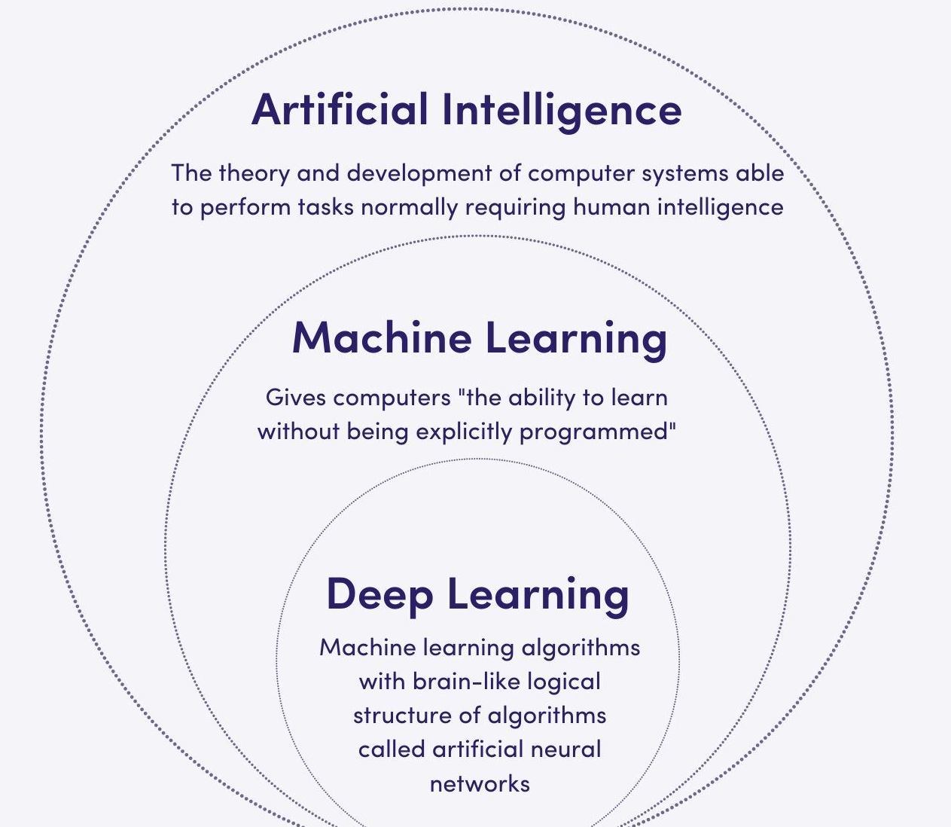
Deep learning, a subfield of artificial intelligence, has revolutionized the field of image classification. Deep learning models use a hierarchy of layers to automatically learn features from the images without the need for hand-crafted feature extraction.

Slide 3
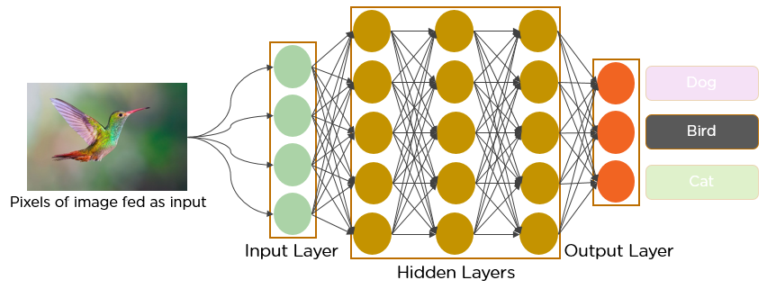
A convolutional neural network (CNN or ConvNet) is a network architecture for deep learning that learns directly from data. CNNs are particularly useful for finding patterns in images to recognize objects, classes, and categories. They can also be quite effective for classifying audio, time-series, and signal data.

Slide 4




TOOLS and PLATFORMS
TensorFlow gives you the flexibility and control with features like the Keras Functional API and Model Subclassing API for creation of complex topologies.
Colab allows anybody to write and execute arbitrary python code through the browser, and is especially well suited to machine learning, data analysis and education.
Automate the training of your own custom machine learning models. Simply upload images and train custom image and video models with AutoML's easy-to-use graphical interface; optimize your models for accuracy, latency, and size; and export them to your application in the cloud

Slide 5
HOW TO INITIATE A DEEP LEARNING PROJECT ?
Define the task
Data Collection
Model training and exploration
Keep track of your model configuration and experiment metadata
Model Refinement
Testing and evaluation
Model Deployment

Slide 6
PNEUMONIA DETECTION SYSTEM
Using Chest X-ray Images

Slide 7
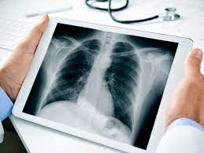
ABSTRACT
Developing an automatic system for detecting pneumonia would be beneficial for treating the disease without any delay particularly in remote areas. Due to the success of deep learning algorithms in analyzing medical images, Convolutional Neural Networks (CNNs) have gained much attention for disease classification. In addition, features learned by pre-trained CNN models on large-scale datasets are much useful in image classification tasks. In this work, we appraise the functionality of pre-trained CNN models utilized as feature-extractors followed by different classifiers for the classification of abnormal and normal chest X-Rays. We analytically determine the optimal CNN model for the purpose. Statistical results obtained demonstrates that pre-trained CNN models employed along with supervised classifier algorithms can be very beneficial in analyzing chest X-ray images, specifically to detect Pneumonia.

Slide 8

INTRODUCTION PNEUMONIA has been one of the most dangerous diseases across the world . Researchers are trying to develop automated and feasible detection systems with the help of deep neural networks, machine learning techniques, etc. In this paper, a deep learning-based PNEUMONIA detection system is proposed that contributes to detecting PNEUMONIA automatically using chest X-ray images. The system introduces classifiers, namely, a multiclass classifier that automatically predicts pneumonia, and a binary classifier that predicts pneumonia classes. Using transfer learning, a deep CNN model is proposed to extract distinct and high-level features from X-ray images in collaboration with the pertained model VGG-19.

Slide 9
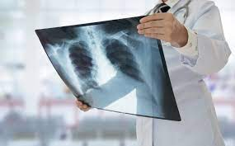

OBJECTIVE
By efficiently training through a relatively image data set, our fine-tuned models show high performance in the classification of pneumonia. Our conviction is that the proposed computer-aided diagnosis mechanism could outstandingly improve the diagnosis of pneumonia cases. This is very helpful, especially in the remote areas.

Slide 10
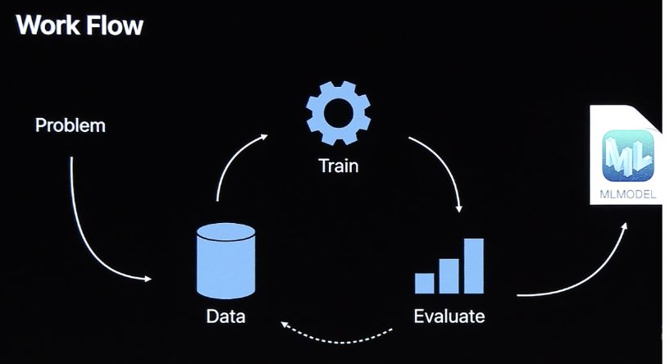
METHODOLOGY
The proposed system extracts distinct features from chest X-ray images. After collecting the dataset from different sources, the dataset is preprocessed. Using transfer learning, pertained model VGG-19 is trained for the model evaluation. Few new layers are added with the base model to avoid the overfitting problem of training the model.

Slide 11
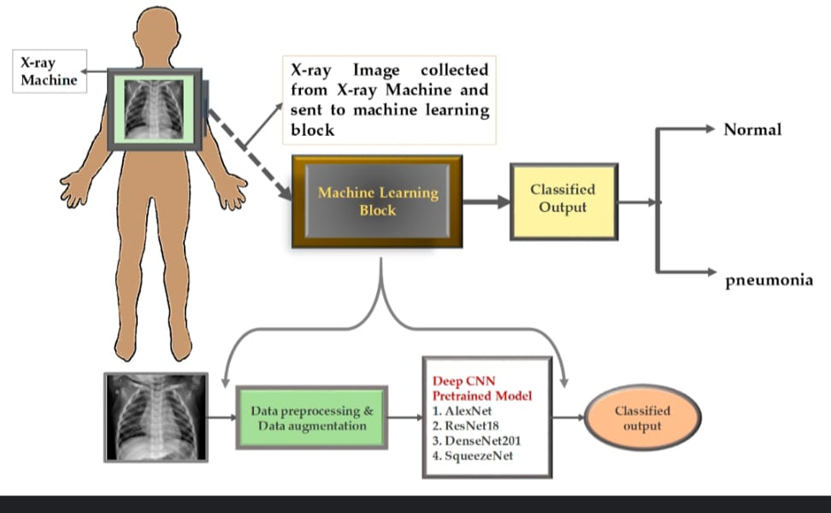

Slide 12
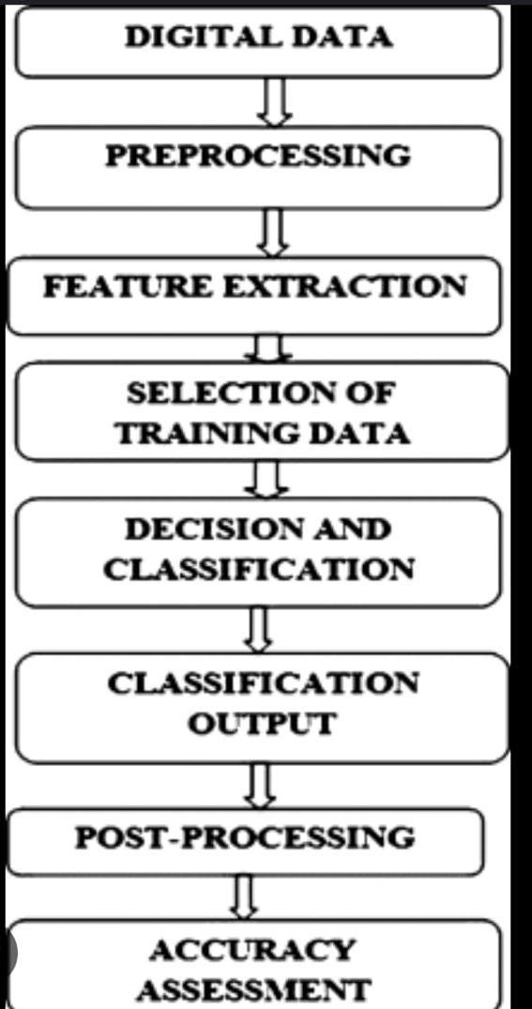
Data augmentation helped the proposed model to perform better with exceptional features of the training images. Convolutional neural network (VGG-19) The features of the image are extracted through a series of convolutional layers. Using transfer learning Transfer learning is a method where a model trained for one classification problem is used in training for another classification problem.

Slide 13
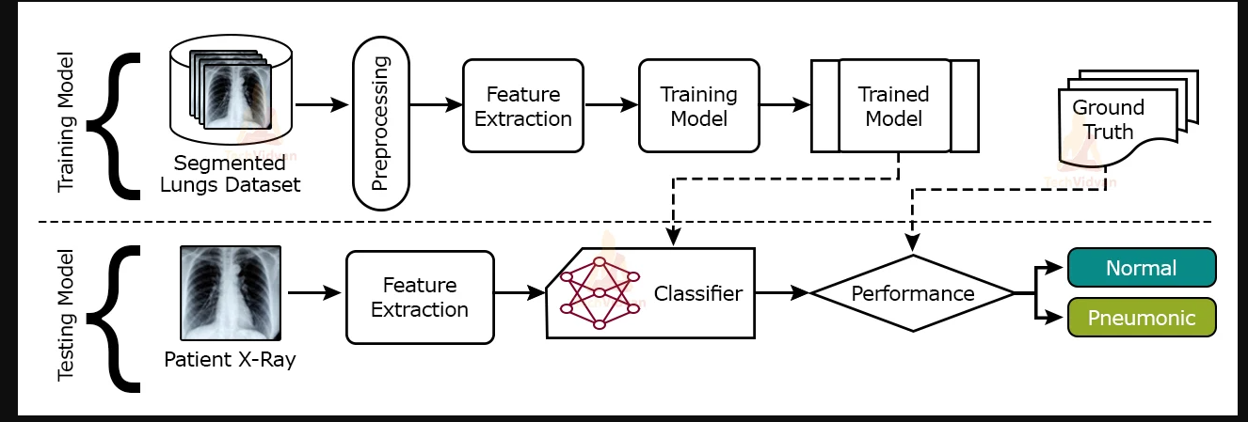
DEMONSTARTION

Slide 14
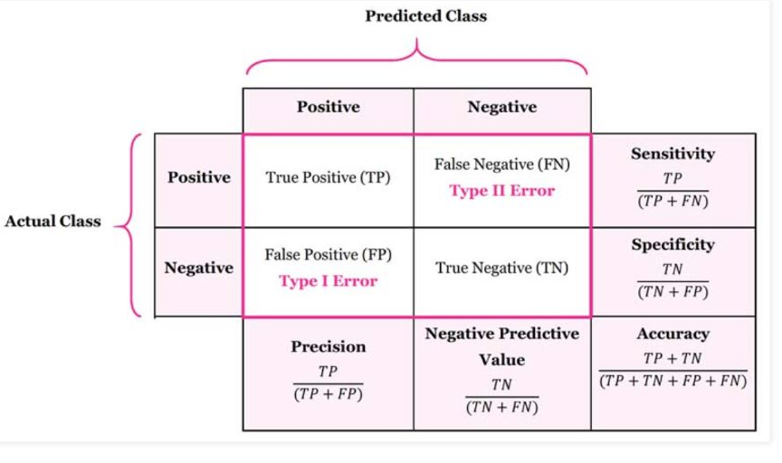
The metrics are evaluated separately for each class label. To evaluate these metrics, four basic terms are: true positives (TP) true negatives (TN) false positives (FP) false negatives (FN) Accuracy=TP + TNTP + TN + FP + FN 0.0<Accuracy
MODEL EVALUATION

Slide 15
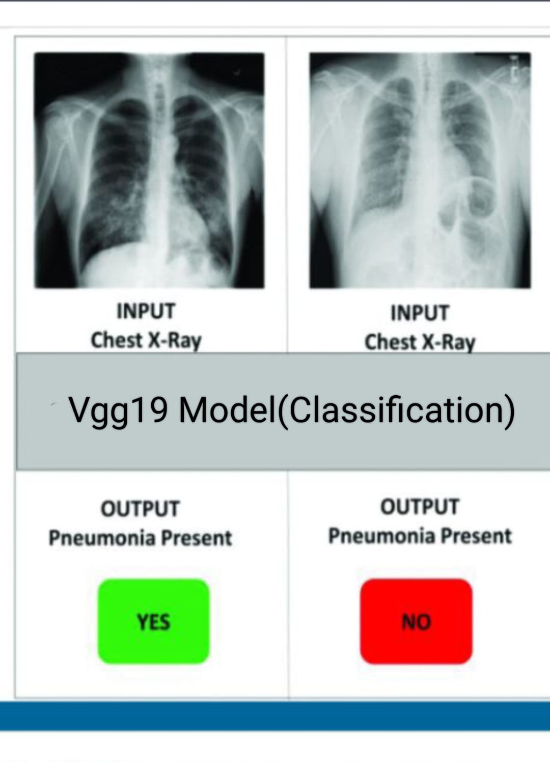
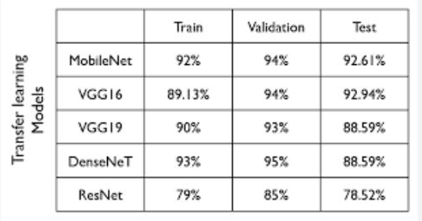
RESULT
On the basis of comparison with other Models
Vgg19 found to be most efficient in predicting the result with 90% accuracy.

Slide 16
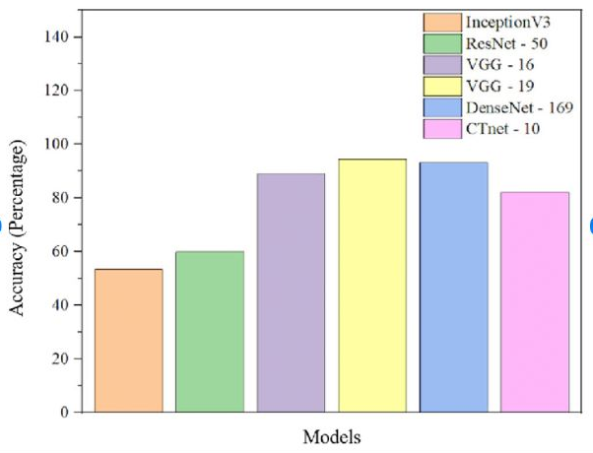
CONCLUSION
The highest accuracy reported in the above-mentioned proposed model Vgg19 in classifying the normal vs. pneumonia patients using X-ray images using deep learning algorithms is 90.84%.
Successfully building Deep Learning diagnosis systems while maintaining people’s privacy is a frontier that the healthcare industry has already established.

Slide 17

FUTURE SCOPE
Early detection of pneumonia increases the survival rate of patients. It is one of the medical systems that help to train radiologists to improve their accuracy of diagnosing pneumonia.
A approach for the automatic detection of pneumonia in energy-efficient medical systems is important :
--To improve the quality
--Reduced cost
--Time response

Slide 18
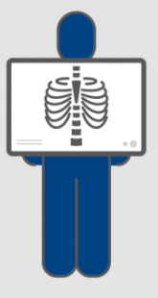
A number of experiments were performed on a dataset of X ray images and evaluated by a set of metrics. All results confirmed the effectiveness and efficiency of the proposed approach.
In future work, a large-sized dataset of different lung diseases will be collected to train the model to improve the healthcare sectors. Moreover, an energy evaluation measure will be used to compute a real result of the energy consumption of the proposed approach.

Slide 19
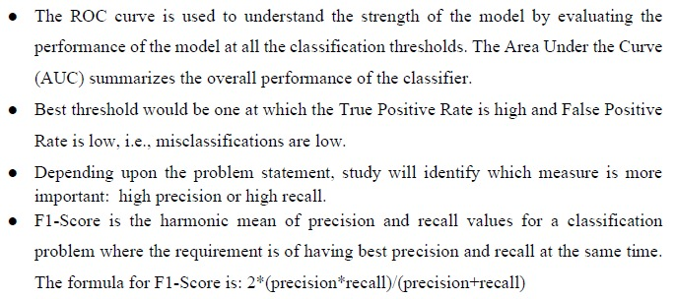
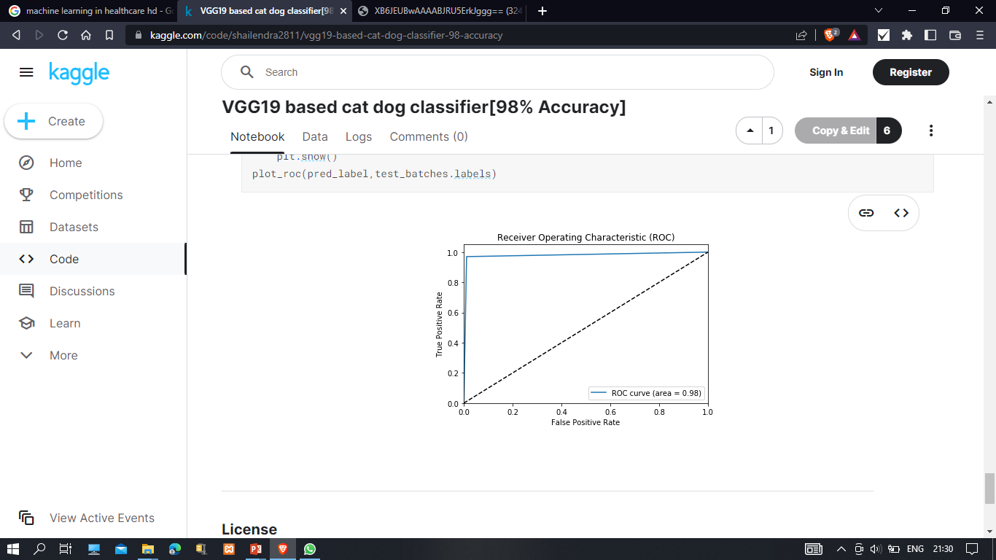
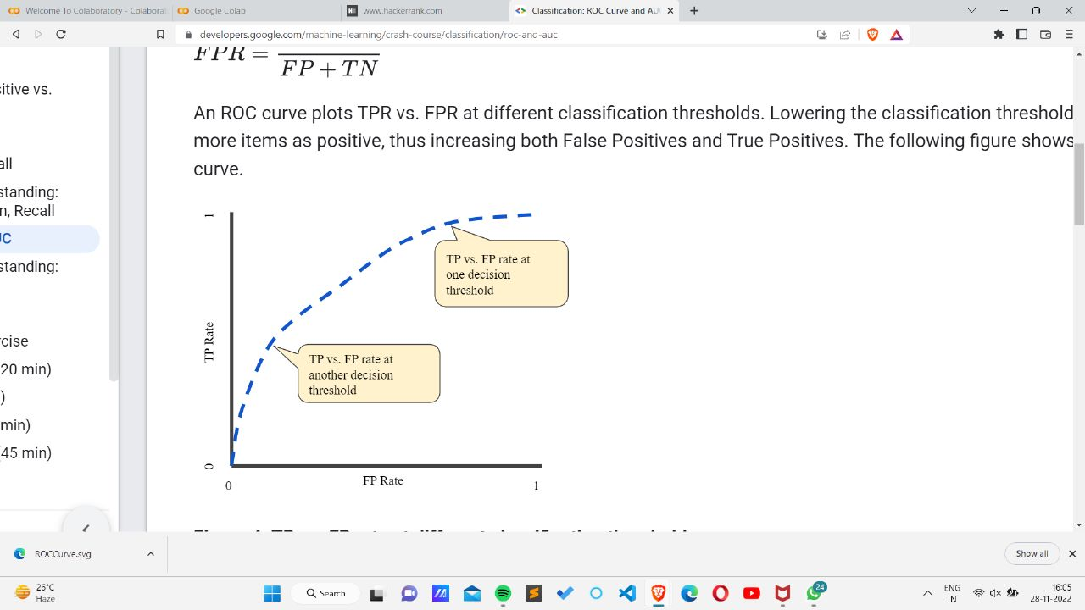
ROC CURVE

Slide 20
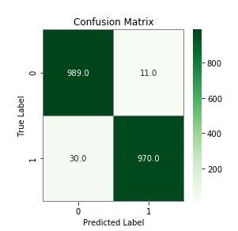
CONFUSION MATRIX
A confusion matrix, also known as an error matrix, is a summarized table used to assess the performance of a classification model. The number of correct and incorrect predictions are summarized with count values and broken down by each class.

Slide 21
REFERENCES
DATASET
https://www.kaggle.com/datasets/paultimothymooney/chest-xray-pneumonia
MODEL
keras.io
Images and other information
techvidvan.com
towardsdatascience.com
www.researchgate.net
www.foreseemed.com
github.com
PLATFORM
colab.research.google.com

Slide 22

By-
RIA KALRA
2101640130061 (IT-II)
TEAM LEADER

Slide 23

THANK you
DO YOU HAVE ANY QUESTIONS?
29861It@gmail.com
6387075810
PDS.com
Please keep this slide for attribution

Slide 24
Model Deployment

